Slide 1
ISO27001:2013 Controls Appendix; Part 11
In this module lets look at ISO27001:2013 (ISMS) related to information security incidents…

Slide 2

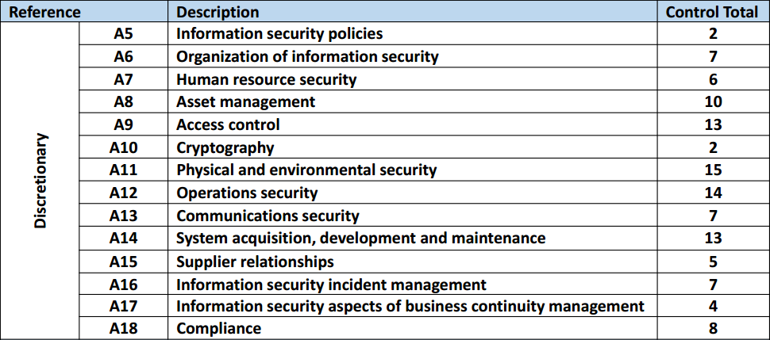
ISO27001:2013 Controls Appendix; Part 11
ISO27001:2013 DISCRETIONARY CONTROLS
TOTAL: 114
https://chapters.theiia.org/bermuda/Events/ChapterDocuments/Information%20Security%20Management%20System%20%28ISMS%29%20Overview.pdf

Slide 3
ISO27001:2013 Controls Appendix; Part 11
A.16 INFORMATION SECURITY INCIDENT MANAGEMENT
A.16.1 MNGMT OF INFOSEC INCIDENTS & IMPROVEMENTS
A.16.1.1 | RESPONSIBILITIES & PROCEDURES
A.16.1.2 | REPORTING INFOSEC SECURITY EVENTS
A.16.1.3 | REPORTING INFOSEC WEAKNESSES
A.16.1.4 | ASSESSMENT OF & DECISION ON INFOSEC EVENTS

Slide 4
ISO27001:2013 Controls Appendix; Part 11
A.16 INFORMATION SECURITY INCIDENT MANAGEMENT
A.16.1 MNGMT OF INFOSEC INCIDENTS & IMPROVEMENTS
A.16.1.5 | RESPONSE TO INFOSEC INCIDENTS
A.16.1.6 | LEARNING FROM INFOSEC INCIDENTS
A.16.1.7 | COLLECTION OF EVIDENCE

Slide 5
ISO27001:2013 Controls Appendix; Part 11
A.16 INFORMATION SECURITY INCIDENT MANAGEMENT
A.16.1.2 | REPORTING INFORMATION SECURITY EVENTS | Control: Information security events shall be reported through appropriate management channels as quickly as possible.

Slide 6
ISO27001:2013 Controls Appendix; Part 11
A.16 INFORMATION SECURITY INCIDENT MANAGEMENT
A.16.1.3 | REPORTING INFORMATION SECURITY WEAKNESSES | Control: Employees and contractors using the organization’s information systems and services shall be required to note and report any observed or suspected information security weaknesses in systems or services.

Slide 7
ISO27001:2013 Controls Appendix; Part 11
A.16 INFORMATION SECURITY INCIDENT MANAGEMENT
A.16.1.5 | RESPONSE TO INFORMATION SECURITY INCIDENTS | Control: Information security incidents shall be responded to in accordance with the documented procedures.

Slide 8
ISO27001:2013 Controls Appendix; Part 11
A.16 INFORMATION SECURITY INCIDENT MANAGEMENT
A.16.1.6 | LEARNING FROM INFORMATION SECURITY INCIDENTS | Control: Knowledge gained from analysing and resolving information security incidents shall be used to reduce the likelihood or impact of future incidents.

Slide 9
ISO27001:2013 Controls Appendix; Part 11
Lets look at business continuity in the next module…
END

